Slide 1
Taiwan Xiao-Chi
Differ between Northern and Southern Xiao-Chi
Northern Xiao-Chi
Southern Xiao-Chi
Shopping List
Differences between northern and southern Taiwanese cuisine
You would find many situations that many differences between northern and southern Xiao-Chi. Mainly it would reflect on flavor that residents prefer. In northern of Taiwanese, we usually prefer salty of food, we also prefer small and delicate cuisine. On the other hand, the flavor of southern Xiao-Chi are much sweeter than northern Xiao-Chi, it could be said that most of the southern Xiao-Chi would contain sugar into it. Additionally, the outlook of southern Xiao-Chi is more simple than northern Xiao-Chi, and also the price and portion of southern Xiao-Chi would be more economic, too. These may be result in the personality discrepancy between northern and southern Taiwanese, southern of Taiwanese usually are considered more optimistic and causal than northern of Taiwanese.
Besides the difference about flavor, outlook, price, and portion, some of the Taiwanese cuisine, they may have the identical name, however essentially, they are not the same cuisine, some of them even are cuisine in northern Taiwan, but are dessert in southern of Taiwan.
The following instances are classic Taiwanese food that they have identical name, but not the same things in northern and southern of Taiwan. For what type is more authentic, sometimes Taiwanese would have funny dispute on the internet.

Slide 2
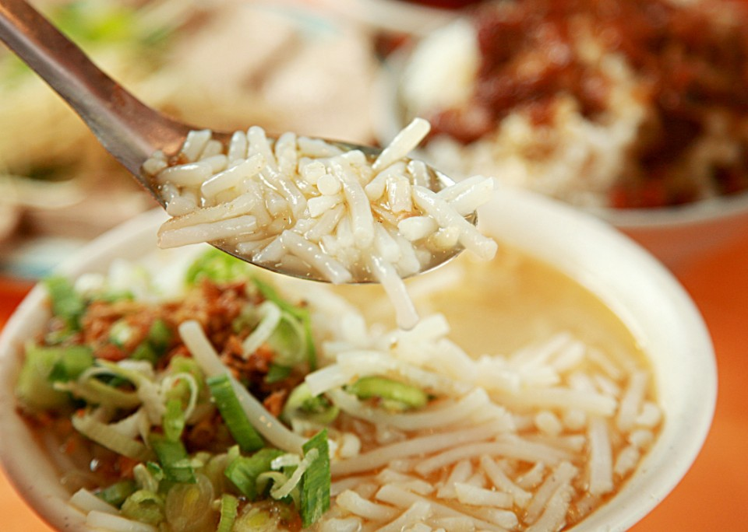
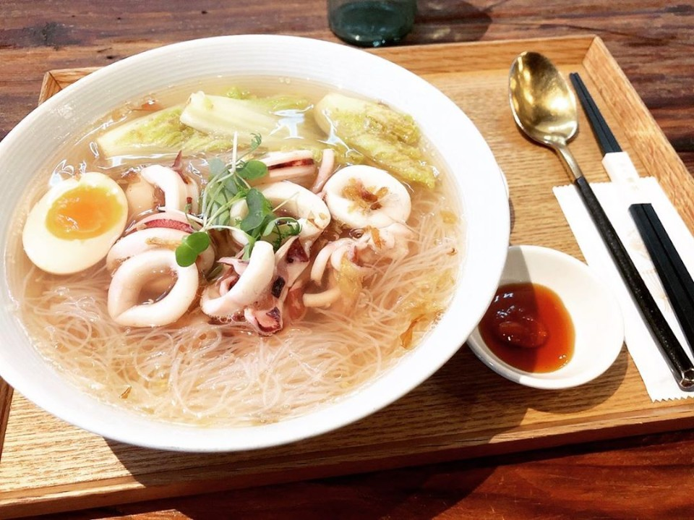
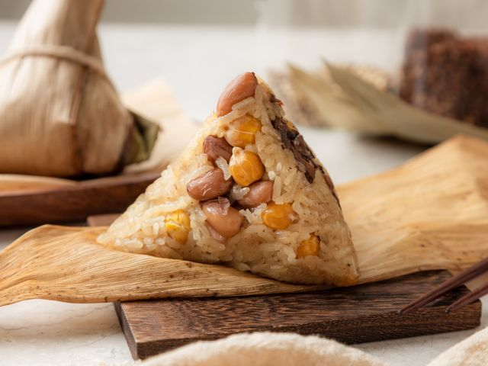
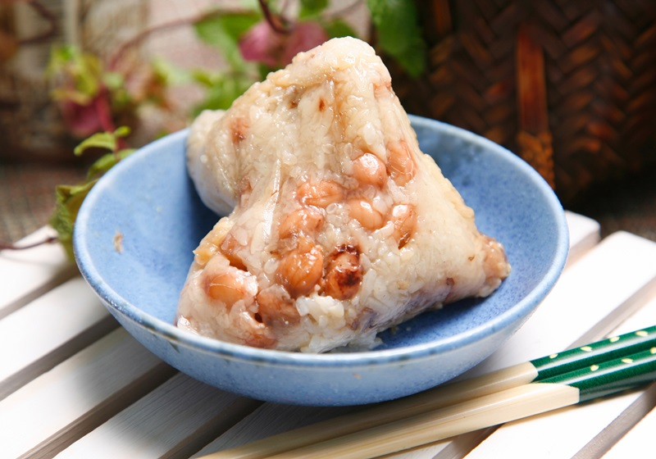
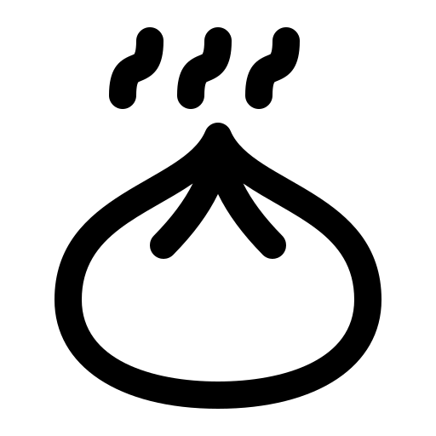




“Bi-Hun”, or translate in English “rice noodle”, is a kind of staple food in Taiwan. As pictures shown at the left side, it could be noticed that northern Taiwan Bi-Hun is short and thick, whereas southern of Bi-Hun has a familiar shape as noodle. Additionally, northern Bi-Hun soup usually only have simple season, however, southern Bi-Hun always also offer meat or seafood in it.
Moreover, northern Bi-Hun has its other name ”Bi-Thai-Bak”, which could only be added into traditional ice in southern Taiwan but could be made as soup and added into traditional ice in northern Taiwan.
Northern Taiwan Bi-Hun soup
Southern Taiwan Bi-Hun soup
Zong-Zi is a famous Chinese cuisine in the world, the shape of it and wonderful flavor makes many western people impressive. In northern Taiwan, people usually previously cooked the ingredients and wrap it into a leaf and steam it only to make it heat. In terms of southern zong-zi, people usually wrap raw ingredients into the leaf and boil to cook it, this method make zong-zi tastier than northern one. Every year in dragon boat festival (festival that people usually eat zong-zi), the fans of northern zong-zi and fans of southern zong-zi would argue which type is authentic zong-zi for a long time. The fan of northern zong-zi would argue southern zong-zi is mushy and the fans of southern zong-zi would fight back that northern zong-zi is just other shape of Png Wan, lack for creativity and feature. Generally, northern zong-zi never win even once because it indeed is a triangle shape of Png Wan, you can buy it very easy in the traditional market near by your house haha.
Northern Taiwan Zong-Zi
Southern Taiwan Zong-Zi
Taiwan Xiao-Chi
Northern Xiao-Chi
Southern Xiao-Chi
Differ Between northern and Southern Xiao-Chi
Shopping List

